Slide 1
Course Title: Engineering Chemistry-1
Course Code: CHE109
(Chapter 7)
Dr. Joyanta Kumar Saha
Associate Professor
Department of Chemistry
Jagannath University

Slide 2

Solution
A solution is a homogeneous mixture of two or more substances on molecular level.
The constituent of the mixture present in a smaller amount is called the Solute and the one present in a larger amount is called the Solvent.
Concentration of a solution: The amount of solute present in a given amount of solution.
A solution containing a relatively low concentration of solute is called Dilute solution. A solution of high concentration is called Concentrated solution.

Slide 3
A saturated solution is defined as one which is in equilibrium with the excess of solid at a particular temperature.
When a saturated solution prepared at a higher temperature is cooled, it gives a solution which would contain more solute than the saturated solution at that temperature. Such a solution is called a supersaturated solution. Supersaturated solutions are quite unstable and change to the saturated solution when excess of solute precipitates out.
Solubility: The solubility is defined as the concentration of the solute in solution when it is in equilibrium with the solid substance at a particular temperature. When a solid is added to a liquid and the solution process takes place the concentration of the solute in the solution increases.

Slide 4
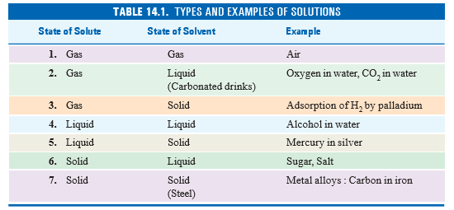
TYPES OF SOLUTIONS

Slide 5



WAYS OF EXPRESSING CONCENTRATION
There are several ways of expressing concentration of a solution :
Per cent by weight (b) Mole fraction (c) Molarity (d) Molality (e) Normality
Per cent by Weight: It is the weight of the solute as a per cent of the total weight of the solution.
Mole Fraction: The ratio of the number of moles of solute and the total number of moles of solute and solvent.
Molarity: The number of moles of solute per liter of solution (M).

Slide 6


Molality: Molality of a solution (symbol m) is defined as the number of moles of solute per kilogram of solvent.
Normality: Normality of a solution (symbol N) is defined as number of equivalents of solute per liter of the solution.

Slide 7
Dilute Solutions: Dilute solutions containing non-volatile solute exhibit the following properties
Lowering of the vapour Pressure
Elevation of the Boiling Point
Depression of the Freezing Point
Osmotic Pressure
These have been grouped together under the class name Colligative Properties. A colligative property may be defined as one which depends on the number of particles in solution and not in any way on the size or chemical nature of the particles.

Slide 8

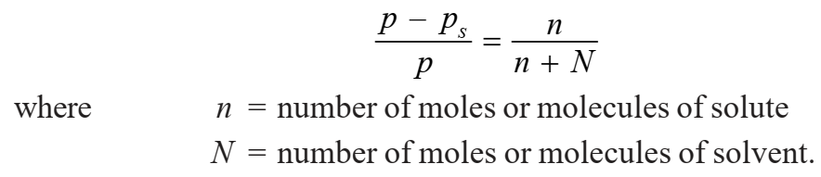
LOWERING OF VAPOUR PRESSURE : RAOULT’S LAW: The vapour pressure of a pure solvent is decreased when a non-volatile solute is dissolved in it. If p is the vapour pressure of the solvent and ps that of the solution, the lowering of vapour pressure is (p – ps). This lowering of vapour pressure relative to the vapour pressure of the pure solvent is termed the Relative lowering of Vapour pressure. Thus
Raoult (1886) gave an empirical relation connecting the relative lowering of vapour pressure and the concentration of the solute in solution. This is now referred to as the Raoult’s Law. It states that : the relative lowering of the vapour pressure of a dilute solution is equal to the mole fraction of the solute present in dilute solution.

Slide 9
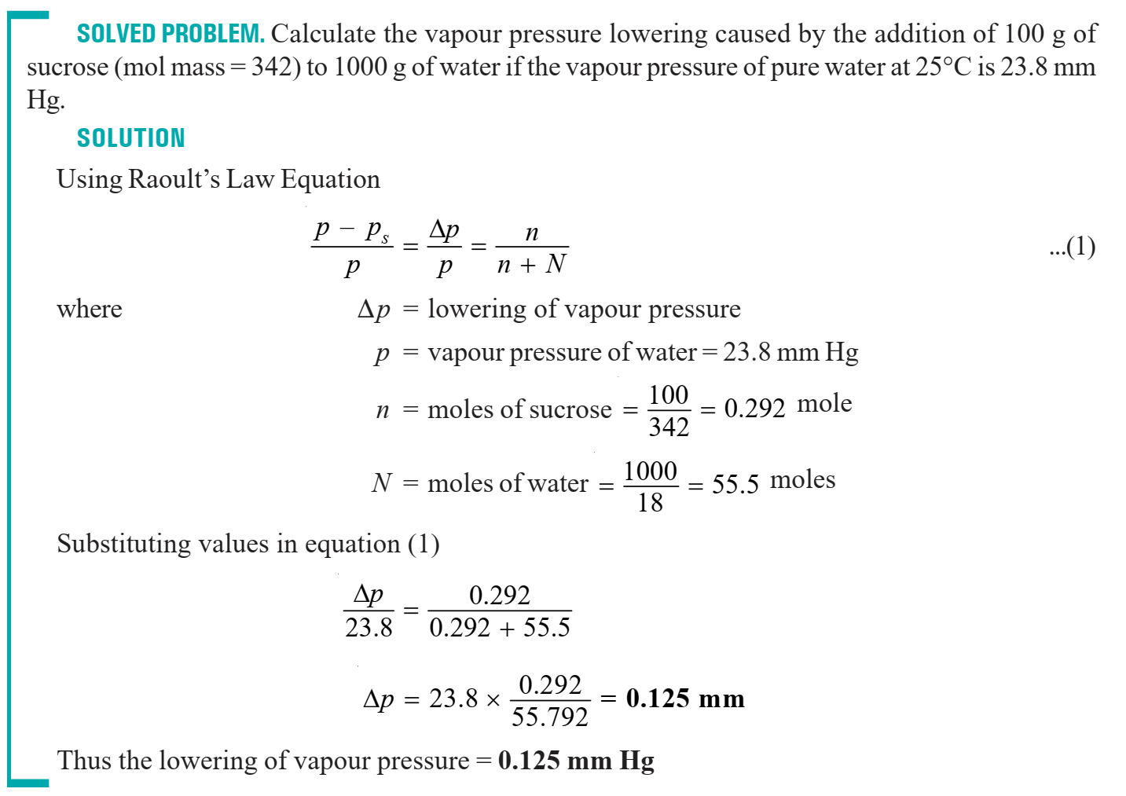

Slide 10
